Slide 1
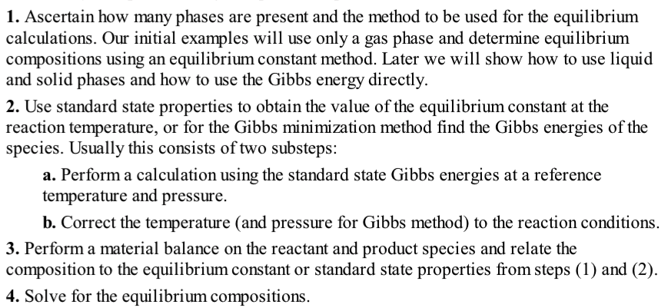

Slide 2
Rate Constant vs. Equilibrium Constant
Reaction rate constant k
How fast will the reaction proceed?
Activation Energy E_{a} for the reaction.
Arrhenius (1890’s) (Forced global
warming predicted 1896)
Eyring, Polanyi, Evans Rate Theory
Gasoline in a gas tank does not explode due to kinetic limitations.
Gasoline is reactive but kinetically stable
Reaction equilibrium constant K_{a}
Will the reaction proceed?
Endergonic, Exergonic
Endothermic, Exothermic
What are the equilibrium concentrations?
Gibbs free energy change in the reaction.
Gasoline in an engine can ideally produce
46.4 MJ/kg at equilibrium.
Gasoline is not thermodynamically stable.
K_{a}

Slide 4
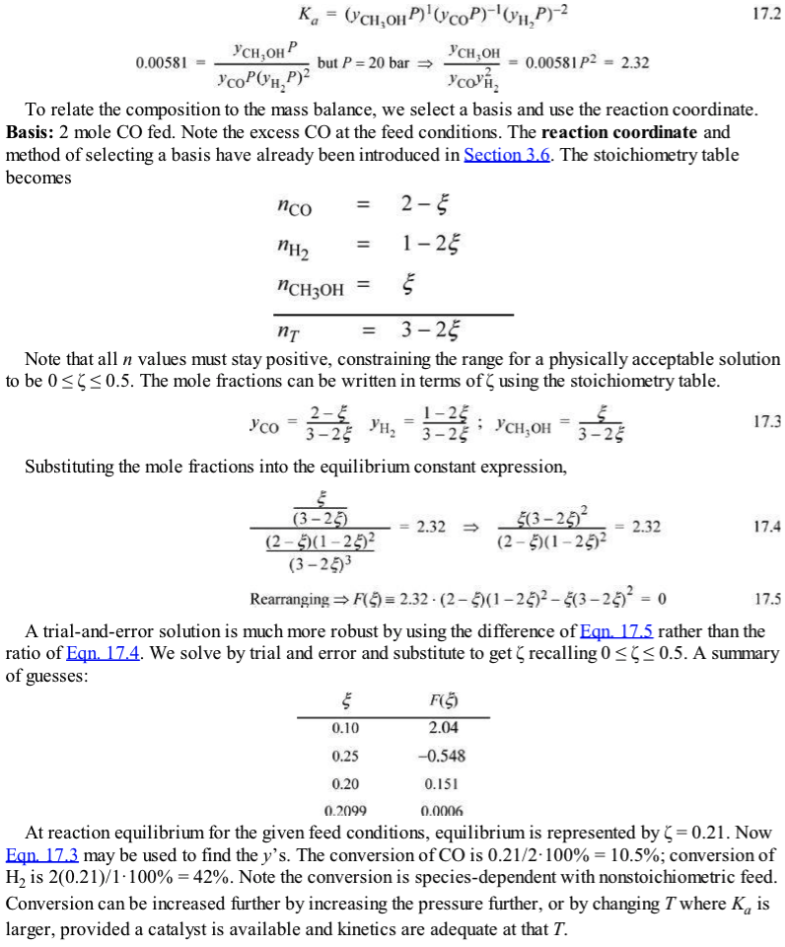

Slide 6
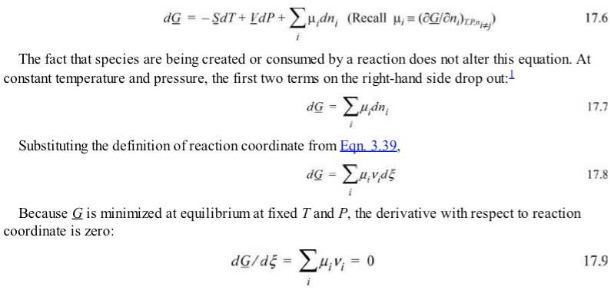

Slide 9
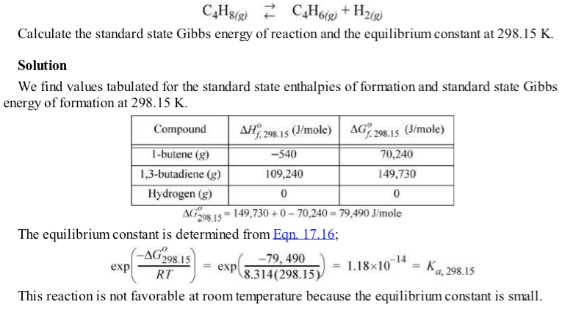

Slide 11
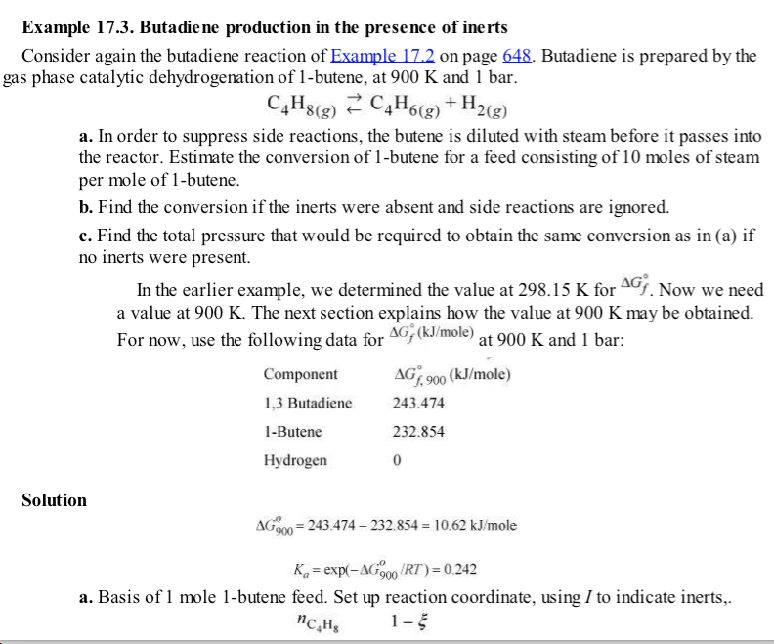

Slide 12
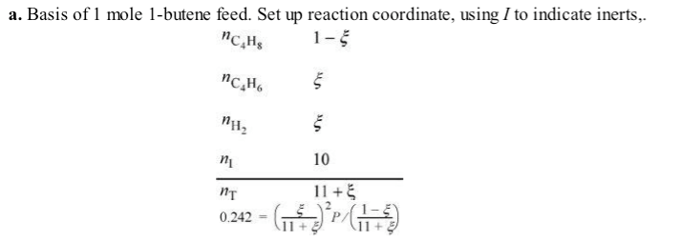
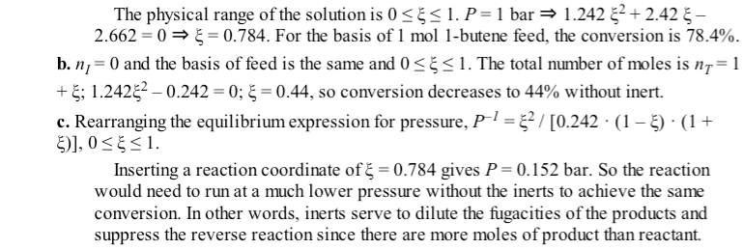

Slide 13
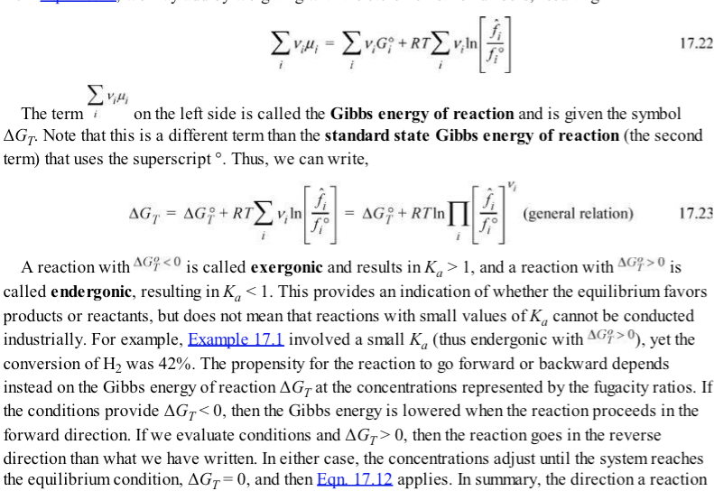

Slide 16
Standard heat of reaction
Standard heat of reaction

Slide 17
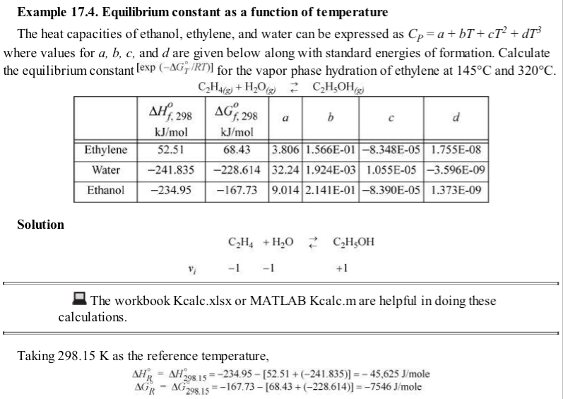
-7.5

Slide 18
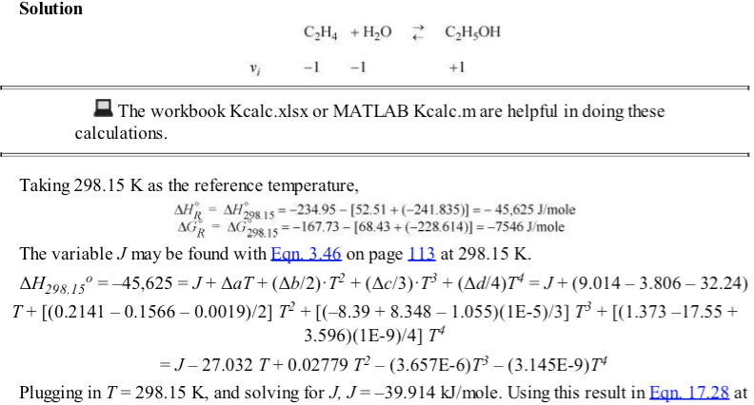
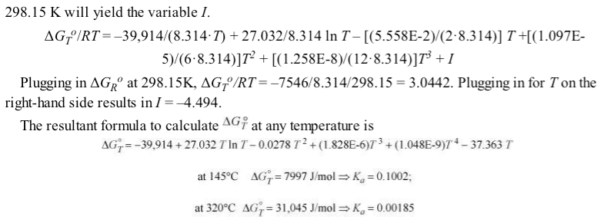

Slide 19
Assume all species same size and all g or all l
Assume ΔCp = 0
So J =ΔH_{R}⁰

Slide 20
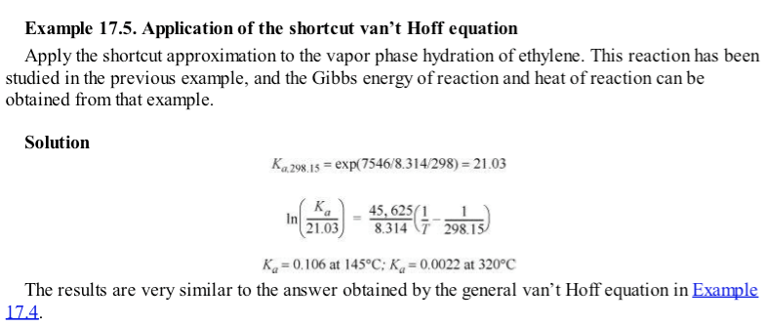
Example 17.4

Slide 21
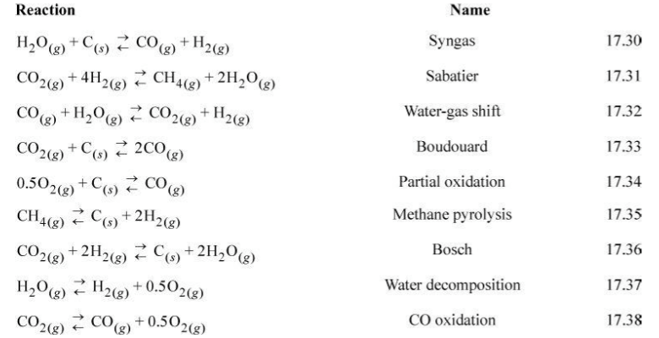

Slide 22
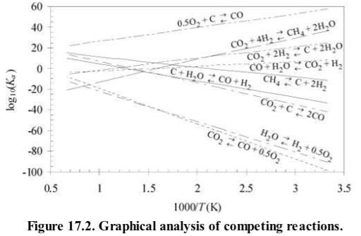

Slide 23
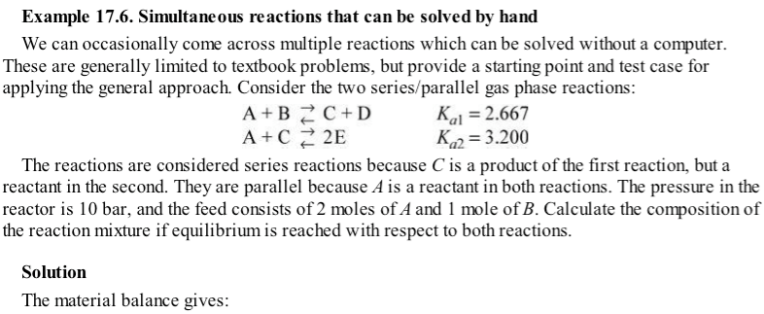

Slide 24
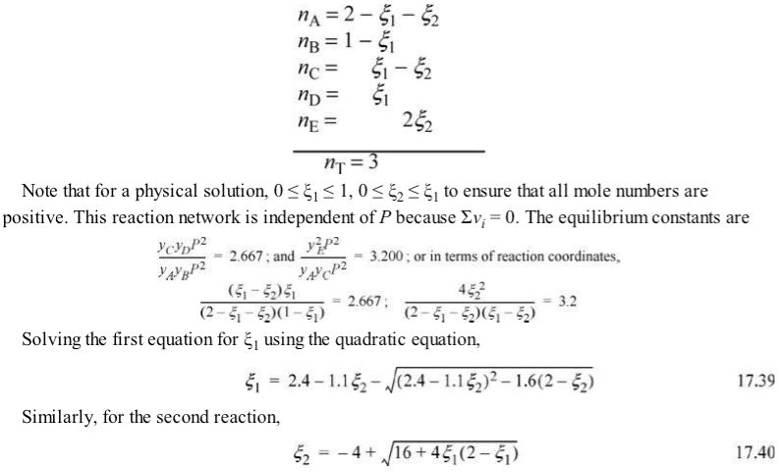

Slide 25
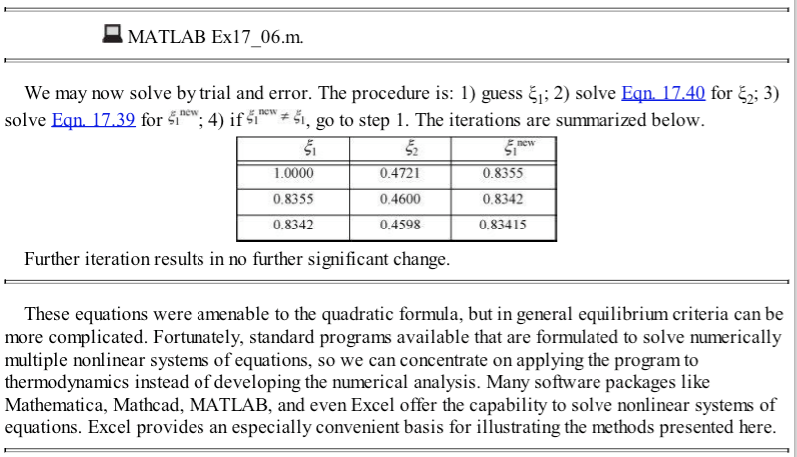
Example 17.6 excel

Slide 27
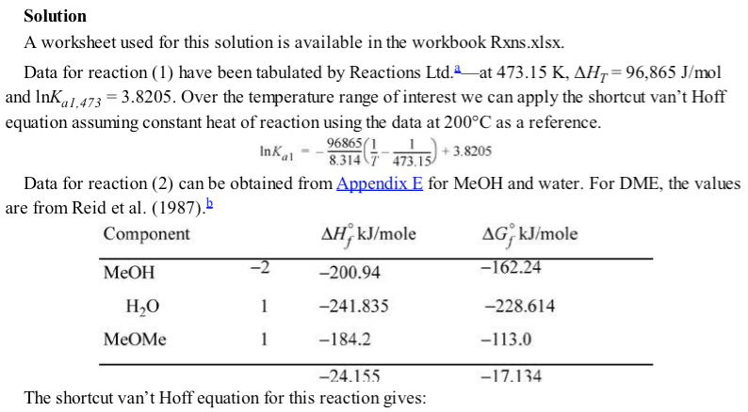

Slide 28
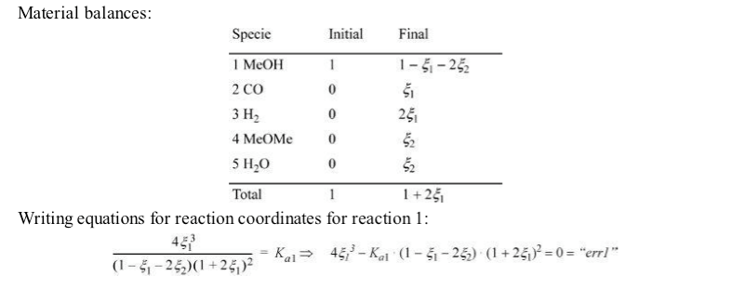
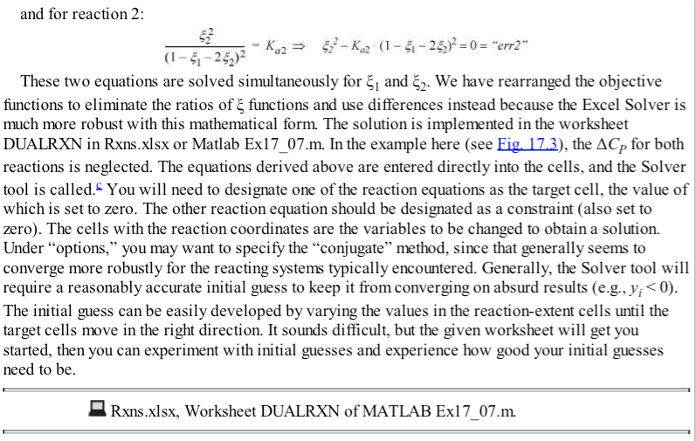
P²
P²

Slide 29
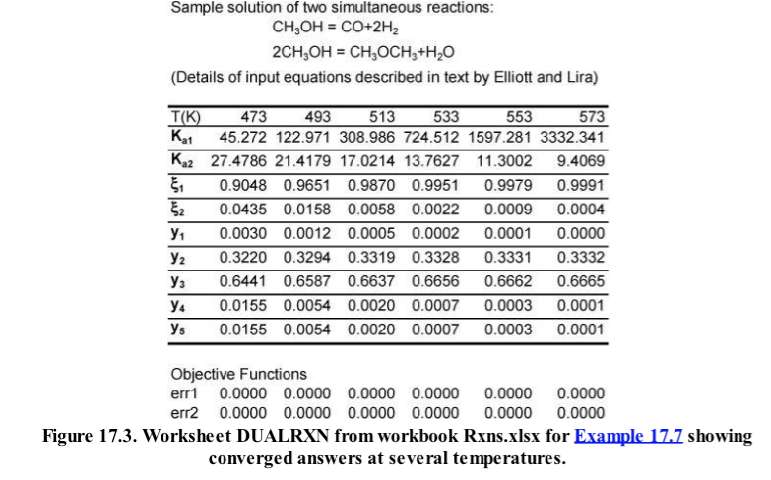

Slide 30
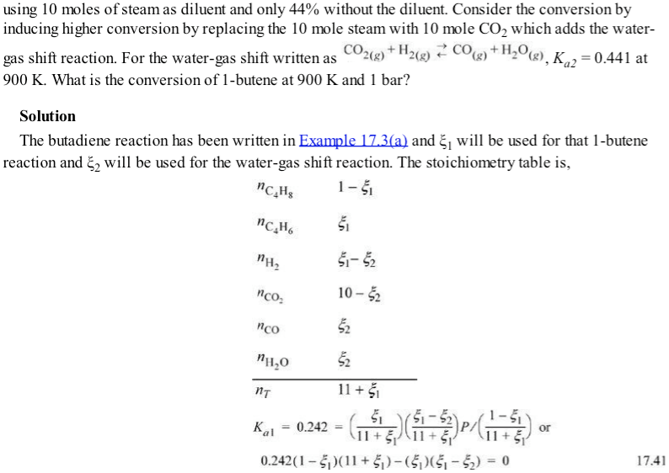

Slide 34
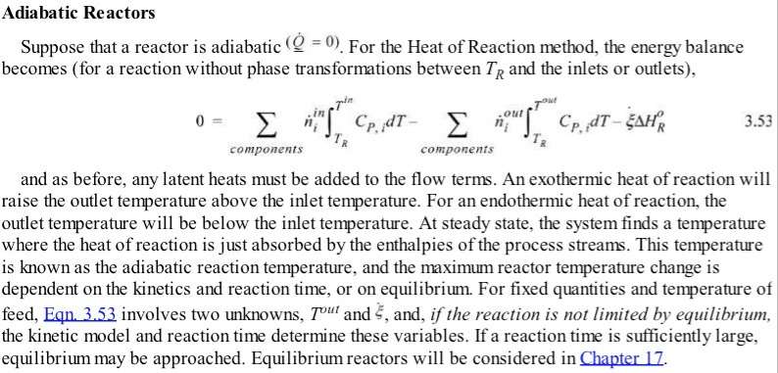
Section From Chapter 3

Slide 35
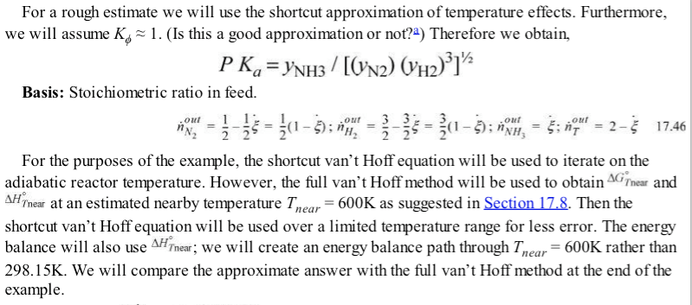

Slide 36
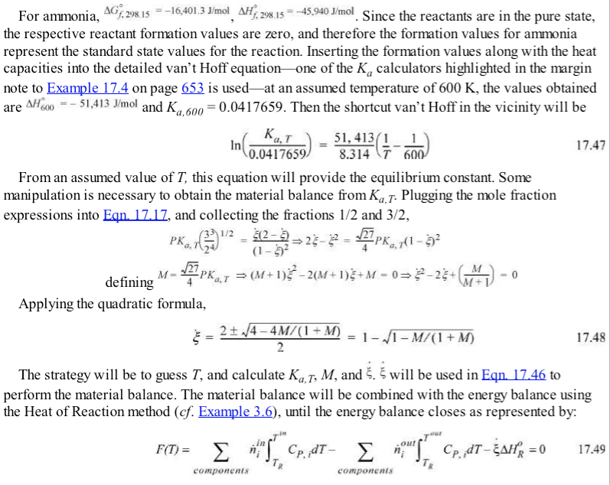
Kcalc.xls

Slide 37
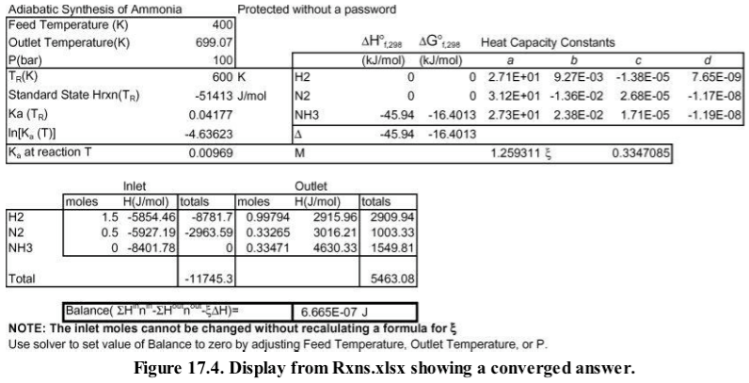

Slide 40
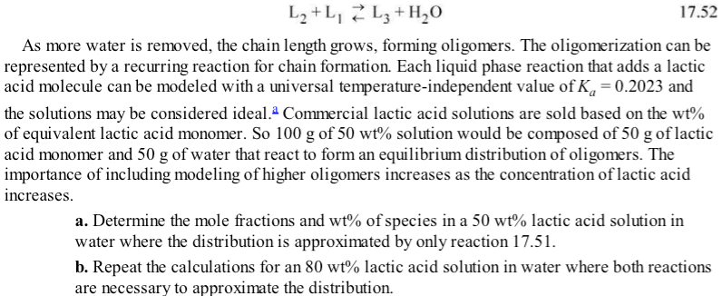

Slide 41
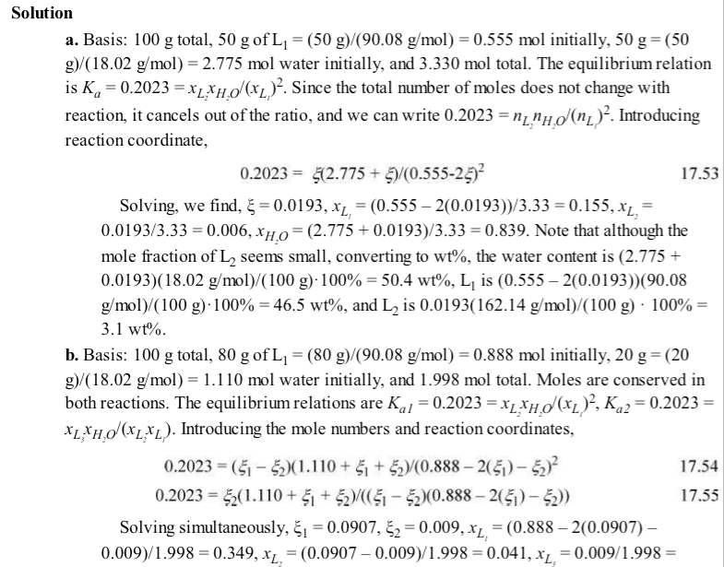

Slide 44
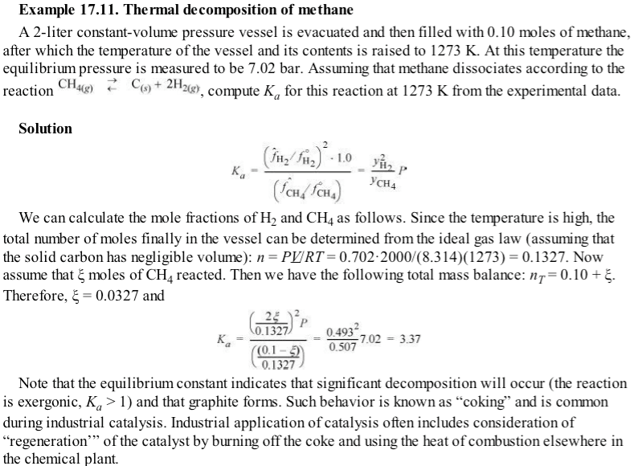

Slide 48
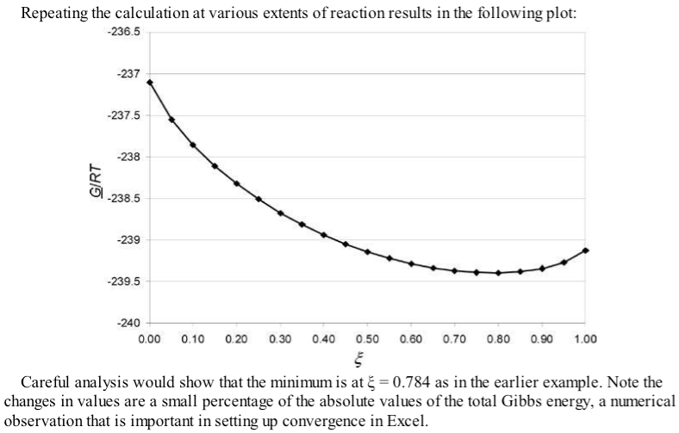

Slide 49
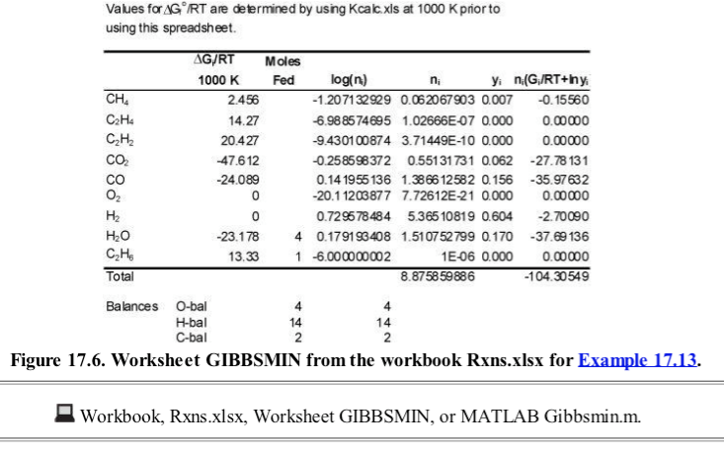

Slide 50
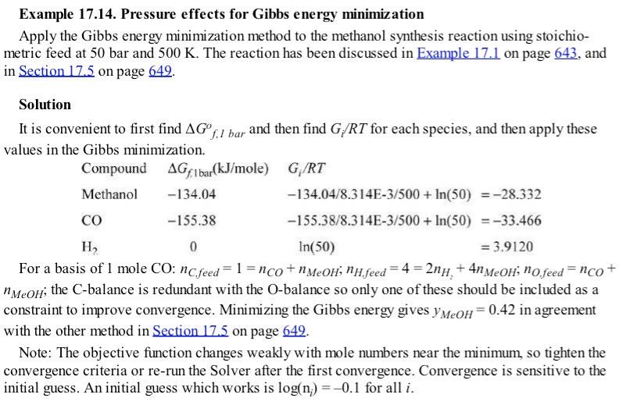
These are molar for pure
components, y_{i} = 1; n_{i} = 1

Slide 52
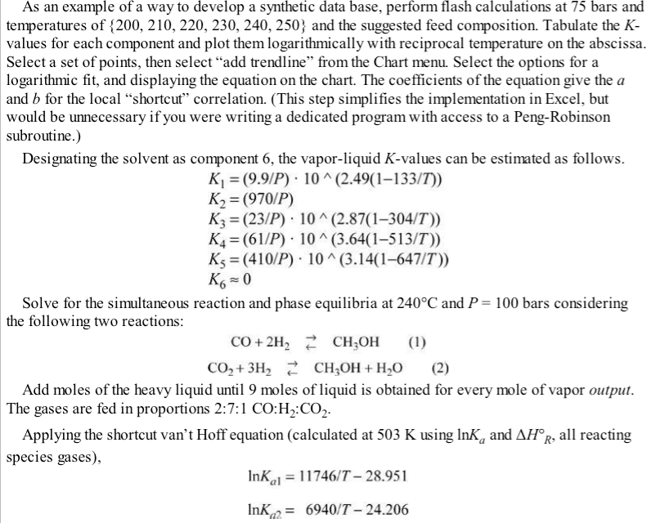

Slide 53
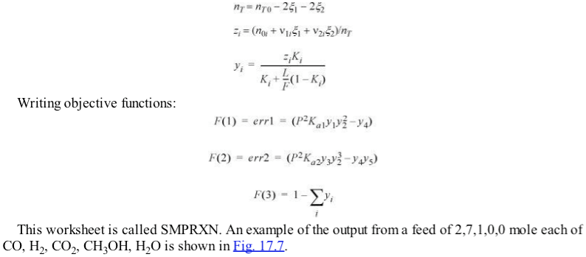

Slide 54
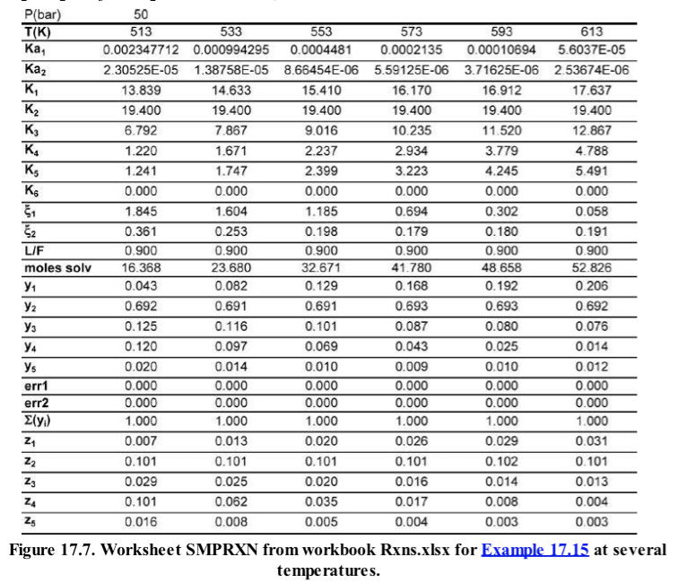

Slide 55
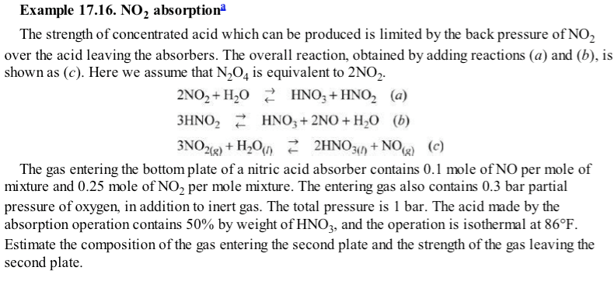

Slide 56
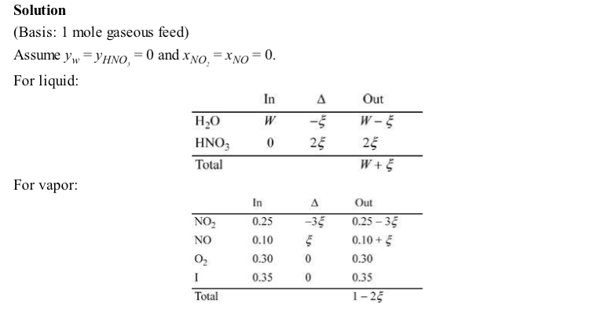

Slide 57
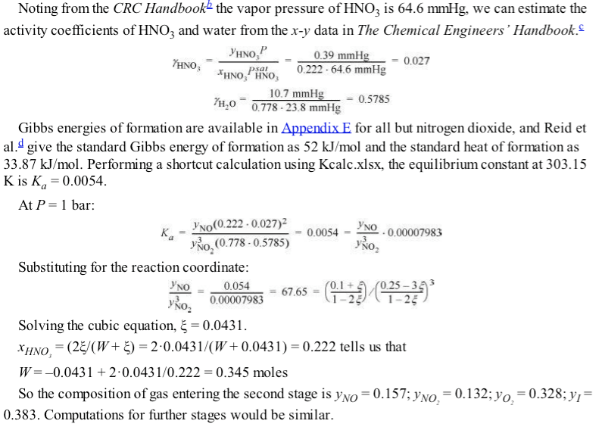

Slide 59
17.7
17.22
Practice Problems 17.1, 17.4, 17.9
Test-yourself’s OK but short

